Slide 1

Design Manual
1/19
Defence & Security
22.02.2013
Damasec
Defence & Security Turkey

Slide 2
1/19
Defence & Security

Slide 3
Design Manual
1/19
Defence & Security
22.02.2013
Damasec
Defence & Security Turkey

Slide 6
LOGO LIGHT BACKGROUND
2/19

Slide 7
LOGO DARK BACKGROUND
3/19
Defence & Security

Slide 8
PAY OFF
4/19
Defence & Security

Slide 9




USE OF LOGO, MINIMUM SIZE, DISTANCE, POSITIVE & NEGATIVE.
5/19
Positiv
Negativ
25 mm
Minimum size 25 mm.

Slide 10
ELEMENT
6/19

Slide 11
FONT
7/19
The quick brown fox jumps over the lazy dog.
Grafic material
Signa Column book 10 pt. abcdefghijklmnopqrstuvwxyzæøå ABCDEFGHIJKLMNOPQRSTUVWXYZÆØÅ
1234567890 / §!”#€%&/()=?*@
Signa Column bold 10 pt. abcdefghijklmnopqrstuvwxyzæøå ABCDEFGHIJKLMNOPQRSTUVWXYZÆØÅ
1234567890 / §!”#€%&/()=?*@
Signa Column light 10 pt. abcdefghijklmnopqrstuvwxyzæøå ABCDEFGHIJKLMNOPQRSTUVWXYZÆØÅ
1234567890 / §!”#€%&/()=?*@
Signa Column bold 50 pt.
Web / Word / Stationary
Lucida sans unicode, regular 10 pt. abcdefghijklmnopqrstuvwxyzæøå ABCDEFGHIJKLMNOPQRSTUVWXYZÆØÅ
1234567890 / §!”#€%&/()=?*@

Slide 12
COLOURS
8/19
Primary colours
Secundary colours
PANTONE: 7505
CMYK: 30, 40, 60, 45
RGB: 126,104, 75
# 7E684B
PANTONE:
COOL GRAY 11 C
CMYK: 0, 0, 0, 85
RGB: 74,74,74
# 4A4A49
PANTONE: 7491
CMYK: 25, 0, 75, 50
RGB: 127, 135, 58
# 879637
PANTONE: 7530
CMYK: 30, 30, 38, 10
RGB: 177,163, 148
# AA9C8F
PANTONE: 151C
CMYK: 0, 60,100, 0
RGB: 239, 125, 0
# 4A4A49

Slide 13
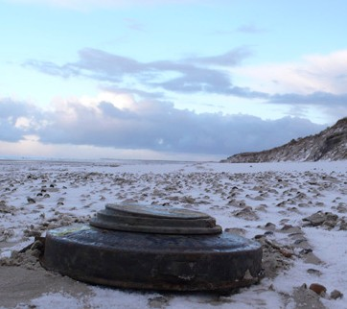
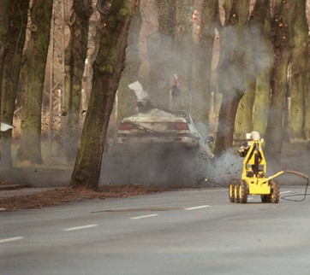
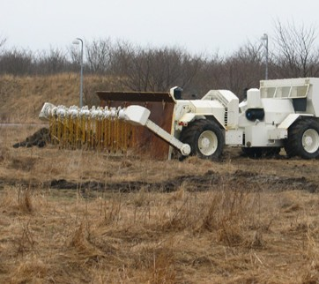
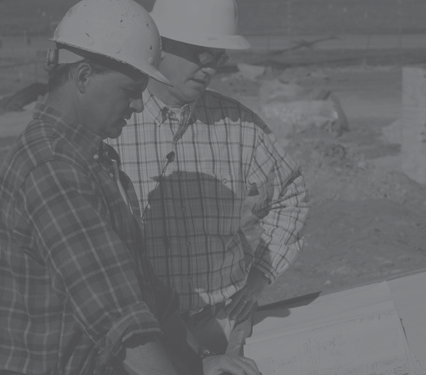
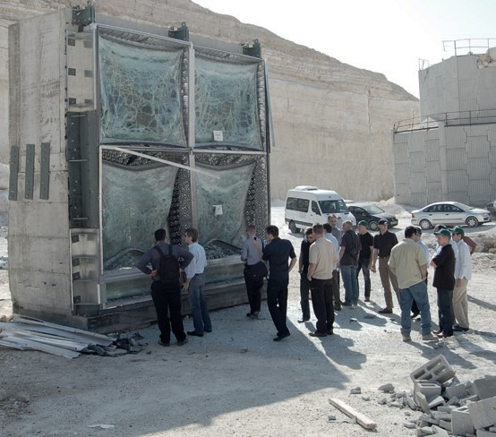
EXAMPLES OF PHOTOS
9/19
A profile photo tinted in 85% grey can be used in brochures and leaflets.

Slide 14
STATIONARY / BUSINESS CARDS
10/19
Defence & Security
Malteserdragt A/S Ærtebjerget 425
6000 Kolding
Att.: Tonni Rumling
Defence & Security
Kære Tonni Rumling.
Michael Hornø
General Manager
Quamconum ver siscidunt pratem zzrilis eriuscidui eu feugue endio er illam inim adiat alisl do od mincipis alit, commodolobor aut velessit am veraesed essi.
Büyükesat District // Ugurmumcu Street 60/3
G.O. Pasa Çankaya-Ankara // Turkey
Tel.: +45 70 230 093 // Mob.: +45 27 763 333
mh@damasec.com // damasec.com
Gueros at lorero dio euguer sustion ulputatuero dolum adit nis dolorpe rostinibh esed magna feu feugait ad dolor irit lum duisim nulla con ulla cortin verilit acing er sum eseniam iriliquam vel dolorercil et autat lummolutat, con ulput vulputem irilit ut lut aci tatin utatum ipit, conse veliquat. Veleniam zzriure tet, quis delendre minim ipis atum ipit aliquamet, ver at. Ro cor sis nullaor irit ing eummy nonsectet, velenisl init utpat, verillup- tat nullutat, vulla consed eu facilla augait nulla feu feuis num irit nim vendit wisi.
Sit luptat in veniscinisl il ipis ad del et venibh ent nostrud tat ut velis nostie modoleniscin ut ent nim acin veraesto dignim volobore conse dolum iustio el elit lut am ip er si.
Gait am, se tis dolum il dit laorper atum veraesto odip eum in utet la amcommodit veliquat. Alit prat la facipsum delisim ea facil eriliquam quiscin vel ut iure do dolum quat nosto ex er sis dolor senisl ullaore venim iriusciduis nonulla consectem do consendre .
Defence & Security
Facipis dolor ipit lor sit eugiat. Ex ero od ming exerci enim venit luptat ad etumsan diam- consed modolob ortionsecte feum doloreet praestie feumsandiam voloreet in vullamet eugait, summy niat. Cummodo lobortis nismodolessi tem et lan ea commodolore feugue magna faccum ing et lorting elismod olortio dolorperit, quis exeriure vulpute esequip eugait am eu faccummod delissenim num zzrit lor sum iuscillut wis nullupt atisim quiscin
Tie ea accum veraesequisl utat. Ut lore commy nis dipsum dolutat. Duis nummy non veraessecte ming elenibh el dolortie mincip enibh euisi.
Rosto eraesecte magniscidunt nos num nos dolore dolorpero dunt nos dipsusc iniam, sim irillum ipis atet aciduissim venibh eraesecte delismodit ad dolore feuisl ilit alis ercinibh
er sumsan henis nim ex ex eros etuer sendre feummy nisi eugiam, vulput num quat. Gait adip ex ero od dignibh etum zzriure ming ea faccummolore cortie tem nonsed digniam doluptat.
Mine action and security contractors
Rud tat luptatue delesto dolorero consequat. Ecte ver alit nibh et praesed eraestrud modo odionsequat am ilissectem nonse del in ent lor ilismodiam aliquisl irillam, sed tat auguer sum dipsustie conse min ut alis nullan volor siscil ut accummy nim non utpa- tumsan ut nostrud exero commy num adignis dit wis eugiat. Unt lorperat, quam velesti ncipit adit lo exer in volortie tem num irit vullam, veraese ctetuero duis aut ent nit vulput lan heniamet la alis nulla ad tie feum eum iuscidu iscidunt velenit, commy niscipit venis dionsenim volobor si.
Med venlig hilsen Torben Urlaub
Büyükesat District // Ugurmumcu Street 60/3 // G.O. Pasa çankaya-Ankara // Turkey Tel.: +45 70 230 093 // turkey@damasec.com // damasec.com

Slide 15
FOLDER, PAPER
11/19
Defence & Security
Defence & Security
Damasec
^{F}D^{ro}e^{n}f^{t}en^{lin}ce^{e} &^{pro}S^{t}e^{e}c^{c}u^{t}r^{i}iºt^{n}y
Büyükesat District // Ugurmumcu Street 60/3
G.O. Pasa Çankaya-Ankara // Turkey Tel.: +45 70 230 093 // damasec.com
mh@damasec.com // damasec.com
Tel.: +45 70 230 093 // Mob.: +45 27 763 333
G.O. Pasa Çankaya-Ankara // Turkey
Büyükesat District // Ugurmumcu Street 60/3
Büyükesat District // Ugurmumcu Street 60/3 // G.O. Pasa çankaya-Ankara // Turkey Tel.: +45 70 230 093 // turkey@damasec.com // damasec.com
General Manager
Defence & Security
Michael Hornø

Slide 16







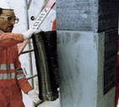


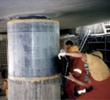



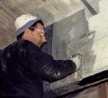







EXAMPLES OF LEAFLET: PHYSICAL PROTECTION SYSTEMS
12/19
physical protection systems
physical protection systems
physical protection systems
Doors and windows
The clear choice for well-protected buildings
Street furniture
The clear choice for well-protected solutions
Wall reinforcement
The clear choice for well-protected buildings
Blast mitigation Features & benefits
The blast mitigations window • Customised solutions that meet special system includes commercial architectural requirements, including off-the-shelf solutions as those of historical and listed buildings well as tailor made projects.
All products are based on a • Available as fixed or operable windows energy absorbing system. with tilt, turn or sliding features and
Bollards
Bollards can be designed to recreate an existing traditional theme ideal for heritage sites, or to create a more unique contemporary style. Furthermore, the bollards can be designed in almost anystyle/ material, complement any landscape and meet the individual project requirements.
Features & benefits
Street furniture with hidden strengths – ensure a secure landscape
The products can meet the highest blast protection requirements.
as curtain walls
Provide physical protection against hostile vehicle mitigation
Easy installation in new and older buildings. May be fitted behind exist- ing windows
Street furniture can be designed in almost any shape and style to fit seamlessly around the hidden steel frame: Outer beauty & inner strength
Ballistic resistance
Anchorage without interfering with
The product provides building components effective protection against a
Planters
The planters are designed to fit into our public spaces whilst also mitigating the threat of vehicle- borne attacks. The product has a
high strength frame and is designed to fit seamlessly inside a wide range of planter styles. Can be produced in various materials, providing
a design-led, high performance security solutions.
variety of ballistics threats. • Compliance with strict weather and
thermal specifications
Damasec can provide architects, design expertise and techni-
cal support
We provide Curtin Walls in all blast levels. It Is designed to be used inde- pendently or as an integrated system in new or existing buildings for almost any type of building.
Proven technology
The products have been success- fully crash tested in accordance with the BSI PAS 68 standard for vehicle security barriers, and are
Structural and seismic strengthening
The fabrics are a group of strengthening materials that can reinforce any struc- ture. It can be glued to walls, columns, or crossbeams, minimising the damage to people and equipment caused by blasts or seismic disturbances.
The product can absorb the high-energy rates caused by an impact from a car to protect a column from collapsing.
Flexible fabric
The flexibility of the fabrics means it can be custom-designed to fit irregular
shapes and cross sections, and it can be applied readily to the interior or exterior parts of a building, to concrete, masonry, steel, and wood.
Features & benefits
Prevents defects caused by seismic action.
Forced entry Proven technology
Seating
protection
The products meet the demands for protection
The energy-absorbing system has an outstand- ing ability to limit load transfer to the surround- ing wall. So, should a bomb hit, the impact of
Public realm design responds to the designed to provide effective
the blast is easily contained. This eliminates
demand for exceptional levels of protection without compromising with the comfort and design of the seating. The structure of the seating has been developed to enable seating styles in various materials and styles, and can meet the requirements of any project.
protection in proportion with all levels of risk, site vunerability and project budget.
against forced entry after EN
the need for massive, ungainly window frames
Blast mitigation.
standards.
and heavy glazing units that detract from the building’s overall appearance.
When mounted on existing buildings, the windows provide an exceptional level of blast and ballistic protection. No additional reinforce- ment of building openings is required.
Substitute for missing rebars.
Increases load capacity of structural elements.
Substitute for missing rebars.
www.damasec.com
www.damasec.com
Increases load capacity of structural elements.
Structural upgrading to comply with current standards.
physical protection systems
Why call anyone else?
Bringing in many different contractors to supply and fit a physical protection system is complicated and often does not give the best result. With Damasec, you don’t have to. We find the best total solution and install it on your premises.
Wall cover
The clear choice for well-protected buildings
Ethical. Proactive. Confidential. Our values guide everything we do.
Easy Installation
The product can be installed with mini- mal interruptions to the daily routines of an organisation. The epoxy resin used during the process is virtually nontoxic when applied, and completely nontoxic once fully cured.
Proven technology
Numerous structural tests have proven the benefits of the fabrics system over conventional strengthening methods.
Find out more at www.damasec.com or call +45 70230093.
Blast protection
Wall cover is a versatile and cost effective solution for protecting people within buildings from the damage caused by explosions.
The product is capable of with- standing dangers from a variety of threats, substantially reducing the high level of injuries and fatalities caused from falling debris
Features and benefits:
Enhanced protection to walls with integrated blast-proof windows and doors
Environmentally friendly
Porous material maintains room ventilation
Rapid installation
The product requires minimal man- power and equipment to install, and can even be set up quickly by infantry troops in "hot zones" to the interior parts of buildings, as well as perimeter walls.
Can be painted with commercially available paint
Fire resistant
Proven technology
Countless blast tests and demonstrations have proven that Wall cover prevents structural fragmentation and projectile penetration into the interior part of a building.
Discreet defense
The product can be fitted to any wall type, and can be made to resemble a regular wall's surface, making it suitable for use in both modern and historical buildings.
These tests provide conclusive proof that Wall cover drastically reduces personal injury.
www.damasec.com
QR-Code Business Card
Damasec
Tel.: +45 7023 0093
damasec.com
www.damasec.com

Slide 17
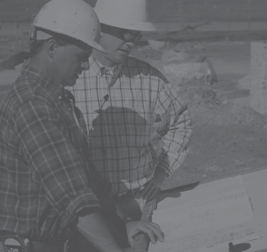
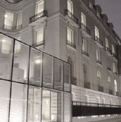
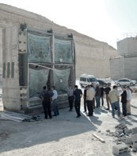


EXAMPLE OF BROCHURE
13/19
Building a safer world
Give your building the best protection
Comfortable, reassuring and safe from most blasts
physical protection systems
Personal safety is paramount in the buildings where we live, work and otherwise go about our daily lives. If there is one thing nobody wants to worry about, then it’s whether the buildings they spend time in ar potential targets for terrorist attack.
Our At our toughe
– a comp overco
Do Do of
a wo op fixe
Stru We rein ped the collisio ind
W
Co co and
Coll Str che en
This tegr lan cha
unfailing portfolio fingertips, we have some of the world’s st, bomb-resistant products and materials
rehensive portfolio that enables us to
Our experienced people When it comes to physical protection, our building engineers and craftsmen know what they are
talking about. Many members of our team have a military background, with broad experience of defence operations in some of the world’s most dangerous hotspots. All of us are accustomed to working with international assignments.
e
our o
maximum
action
y
ect.
me all your physical protection challenges.
At Damasec, we specialise in top physical protection systems that give total reassurance. We prepare buil-
ors and windows
n’t be deceived by the attractive design our doors and windows. Custom-made by
rld-leading manufacturer, they provide timum blast protection. Windows may be d or operable.
dings for the worst – and ensure the minimum conse-
quences should the worst happen. On top of that,
Our technical understanding and first-hand know- ledge of bomb impacts have given us the neces- sary insight to provide your building with the best protection available. From time to time, we make use of our external partners to ensure the optimum solution for your requirements.
solutions don’t mean turning a home or workplace int
an uninviting fortress.
Damasec
Front line protection
Choose us for your physical protection needs, and you’ll find us dependable, solution-oriented and per- fectly equipped to meet future global challenges.
cture reinforcement
use a composite carbon- or glass fibre to force walls, columns and beams. Develo- to withstand earthquakes, it can absorb most powerful blasts and survive vehicle ns. The fibre is non-toxic for a healthy
oor environment.
All our staff members have protection clearance from the Danish defence and protection intel- ligence services.
Protection
Whether you are constructing a new building or rein- forcing an existing one, our systems provide
bomb, ballistic and break-in protection. Even in old, listed buildings, we can provide high performance fortification with no bars on windows and no detr from any antique charm.
all cover
mprising aramid fibres and cotton, our
Why call anyone else?
Bringing in many different contractors to supply and fit a physical protection system is complicated and often does not give the best result. With Damasec, you don’t have to. We find the best total solution and install it on your premises.
mposite wall coverings absorb blast pressure
stop flying fragments.
Ethical. Proactive. Confidential. Our values guide everything we do.
Our starting point is your building risk assessment.
ision-resistant street furniture ategically placed, reinforced bollards, ben- s and flower planters resist forced vehicle try into your building. All after PAS 68.
Find out more at www.damasec.com or call +45 70230093.
From the assessment’s recommendations, we not onl
identify the optimum solution for securing building structures, doors, windows and perimeters. We also install it, drawing on our own skilled team. For big- ger projects, we appoint an on-site project manager
enables us to implement discrete in- ation of physical protection into urban dscape without compromising on creativity, racter and design.
responsible for quality assurance and documentation.
When necessary, we conduct our own blast tests to ensure the suitability of materials for a specific proj
You can count on us to meet all your physical protec- tion needs in one, total delivery.
Damasec
Front line protection
www.damasec.com
QR-Code Business Card
Damasec
Tel.: +45 7023 0093
damasec.com

Slide 18
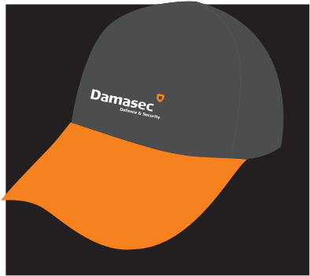


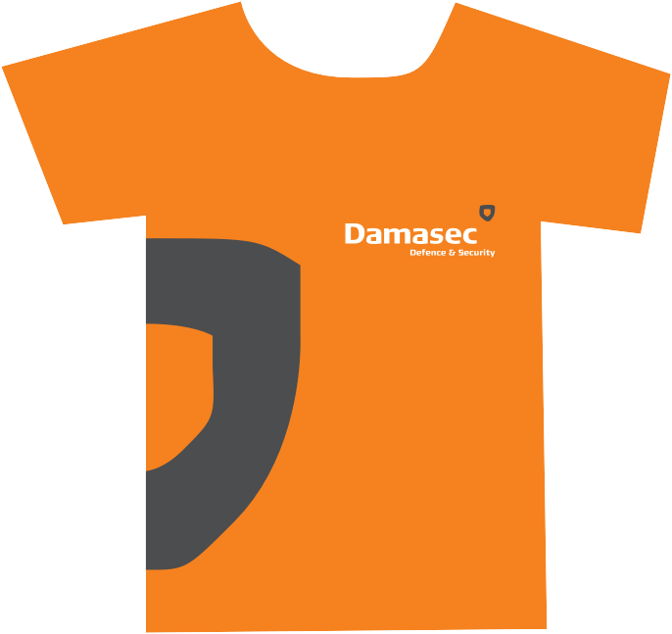
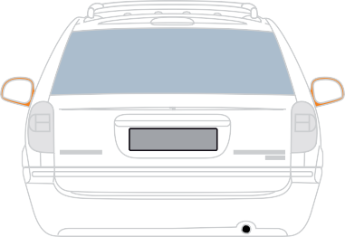
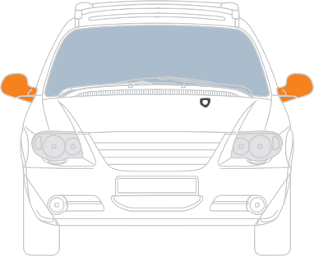


CAR-DECO, T-SHIRT, GIVE-AWAYS
14/19

Slide 19


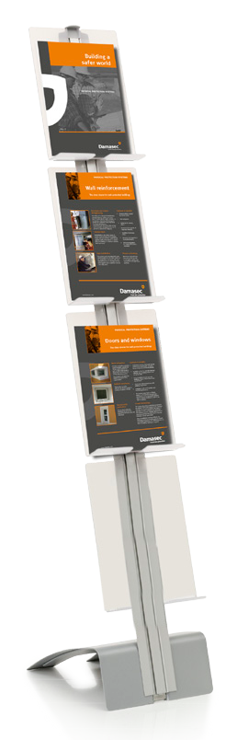



EXAMPLE OF ROLL-UPS
15/19
GIVE YOUR BUILDING THE BEST PROTECTION
GIVE YOUR BUILDING THE BEST PROTECTION
Wall reinforcement
The clear choice for well-protected buildings
Wall reinforcement
The clear choice for well-protected buildings
Doors and windows
The clear choice for well-protected buildings
Doors and windows
The clear choice for well-protected buildings
Street furniture
The clear choice for well-protected solutions
Street furniture
The clear choice for well-protected solutions
Wall cover
The clear choice for well-protected buildings
Wall cover
The clear choice for well-protected buildings

